Slide 1
Topics to be Covered
Generating Functions
  Recurrence Functions

Slide 2
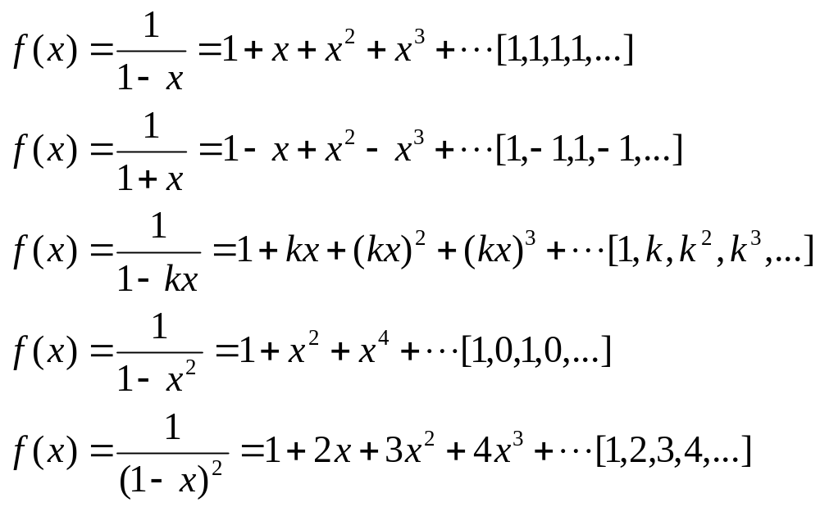
Generating Functions –
Special examples

Slide 3
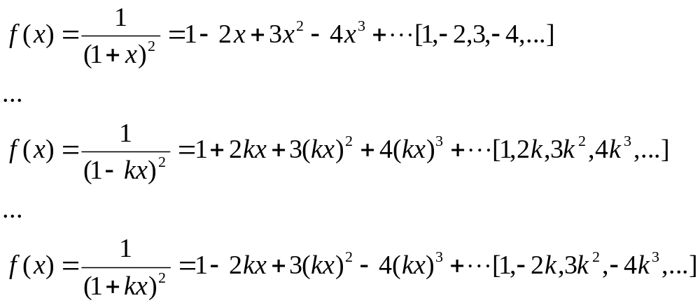
Generating Functions –
Special examples

Slide 4
Recurrence Relations
Consider the following
1. start with 5
2. Given any term, add 3 to get the
next term
If we list the terms we get
5, 8, 11, 14, 17, …

Slide 5
Recurrence Relations
If we write the terms in this list as a₁, a₂, …a_{n}, … we get
a₁ = 5
a_{n} = a_{n-1} + 3 where n ≥ 2
OR
a_{n} = 5 n=1
a_{n-1} + 3 n ≥ 2
This is an example of a recurrence relation

Slide 6
Recurrence Relations
A recurrence relation for the sequence a₀, a₁, a₂, … is an equation that relates a_{n} to certain of its predecessors a₀, a₁, …,a_{n-1}
Initial conditions for the sequence a₀, a₁, …,a_{n-1} are explicitly given values for a finite number of terms of the sequence

Slide 7
Illustration
Write down the first five terms of the sequence defined by a₁ =1, a_{k+1} = 3a_{k}+1 for k ≥1
a₁ = 1
a₂ = 3a₁+1 = 3(1)+1 = 4
a₃ = 3a₂+1 = 3(4)+1 = 13
a₄ = 40
a₅ = 121
.
.
.
a_{n} = ?

Slide 8
Illustration
In this case a formula for the n^{th} term is as follows
a_{n} = (1/2)(3^{n} -1)
This is what is called a solution to the recurrence relation a₁ =1, a_{k+1} = 3a_{k}+1 for k ≥1
Generating functions may be used to solve recurrence relations

Slide 9
First Example
Solve the recurrence relation
a₀ = 1
a_{n} = 3a_{n-1} , n≥1
Solution,
Consider the generating function
f(x) = a₀+a₁x+ a₂x²+…+ a_{n}x^{n}+…
3xf(x) = 3a₀x+3a₁x²+…+3a_{n-1}x^{n}+…
Subtracting…

Slide 10
First Example
Subtracting…
f(x)-3xf(x) = a₀ + (a₁- 3a₀)x + (a₂- 3a₁)x²+…+ (a_{n}- 3a_{n-1})x^{n}
Now Substituting a₀ = 1, a₁ = 3a₀ ,…, a_{n} = 3a_{n-1}
(1-3x)f(x) = 1
f(x) = 1 / (1-3x)
Recall 1 = 1+x+x²+…+x^{n}+…
1-x
So 1 = 1+3x+(3x)²+…+(3x)^{n}+… =
1-3x
= 1+3x+9x²+…+3^{n}x^{n}+…

Slide 11
First Example
a_{n} is the coefficient of the x^{n} term in f(x)
a_{n} = 3^{n}
is the solution of the recurrence relation
1 , n=0
a_{n} =
3a_{n-1} , n≥1

Slide 12
Second Example
Solve the recurrence relation
a_{n} = 2a_{n-1} – a_{n-2}, n>1,
given a₀ = 3 and a₁ = -2
Solution
f(x) = a₀+a₁x+ a₂x²+…+ a_{n}x^{n}+…
2xf(x) = 2a₀x+2a₁x²+ +…2a_{n-1}x^{n}+…
x²f(x) = a₀x²+…+ a_{n-2}x^{n}+…
Therefore,

Slide 13
Second Example
f(x)-2xf(x)+x² f(x) =
a₀+(a₁-2a₀)x+(a₂-2a₁+a₀)x²+…+(a_{n}-2a_{n-1}+a_{n-2})x^{n}+…
= 3-8x
Since a₀ = 3
a₁ = -2
a_{n} – 2a_{n-1}+a_{n-2} = 0 for n >1
Now, f(x)-2xf(x)+x² f(x)
f(x)(1-2x+x²) = f(x)(1-x)²= 3-8x
Therefore, f(x) = 3-8x
(1-x)²

Slide 14
Second Example
Now recall
1 = 1+2x+3x²+4x³+…+(n+1)x^{n}+…
(1-x)²
So, f(x) = (1+2x+3x²…+nx^{n-1}+(n+1)x^{n}+…)(3-8x)
= 3-8x + 6x-16x² + 9x²-24x³ +
…+ 3nx^{n-1}-8nx^{n} + 3(n+1)x^{n}-8(n+1)x^{n+1}+ …
= 3–2x–7x²–12x³+…+[– 8n+3(n+1)]x^{n}+…
= 3–2x–7x²–12x³+…+[-5n + 3]x^{n}+…
And so a_{n} = 3- 5n is the solution to the recurrence relation.

Slide 15
Third Example
Solve the recurrence relation
a₀ = 1
a₁ = 4
a_{n} = -3a_{n-1} + 10a_{n-2} , n≥2
Solution,
Consider the generating function
f(x) = a₀+a₁x+ a₂x²+…+ a_{n}x^{n}+…
3xf(x) = 3a₀x+3a₁x²+…+3a_{n-1}x^{n}+…
10x²f(x) = 10a₀x²+…+10a_{n-2}x^{n}+…
therefore…

Slide 16
Third Example
Subtracting…
f(x)+3xf(x)-10x²f(x) = a₀ + (a₁+ 3a₀)x + (a₂+ 3a₁-10a₀)x²+…+
(a_{n}+ 3a_{n-1}-10a_{n-2})x^{n}+
Now Substituting a₀ = 1, a₁ = 4 ,…, a_{n} + 3a_{n-1} – 10_{n-2} = 0 for n≥2
(1+3x-10x²)f(x) = 1+7x
f(x) = 1+7x
(1+5x)(1-2x)
Recall partial fractions,
1 = A + B
(1+5x)(1-2x) 1+5x 1-2x
1 = A(1-2x) + B(1+5x)
1 = A - 2Ax + B + 5Bx
1 = A + B - 2Ax + 5Bx

Slide 17
Third Example
Equating Numerators,
1 = (A+B)+(-2A+5B)x
So A+B = 1 and (-2A+5B) = 0
Solving for A and B we get A = 5/7 and B = 2/7
Therefore,
1 = 5 1 + 2 1
(1+5x)(1-2x) 7 1+5x 7 1-2x

Slide 18
Third Example
f(x) = 1+7x
(1+5x)(1-2x)
1+7x = 5 1 (1+7x) + 2 1 (1+7x)
(1+5x)(1-2x) 7 1+5x 7 1-2x
= (5/7)(1+(-5)+(-5x)²+….)(1+7x)+
(2/7)(1+2x+(2x)²+…)(1+7x)
= (5/7)(1-5x+25x²+…+(-5)^{n}x^{n}+…)(1+7x)+
(2/7)(1+2x+4x²+…+2^{n}x^{n}+…)(1+7x)

Slide 19
Third Example
= (5/7)(1+2x-10x²+…+[(-5^{n})+7(-5)^{n-1}]x^{n}+…)+
(2/7)(1+9x+18x²+…+[2^{n}+7(2^{n-1})]x^{n}+…)
= (5/7)(1+2x-10x²+…+2(-5^{n-1})x^{n}+…)+
(2/7)(1+9x+18x²+…+9(2^{n-1})]x^{n}+…)
= 1+4x-2x2+…+[ (-2/7)(-5)^{n}+(9/7)(2^{n})]x^{n}+…
Hence a_{n} = (-2/7)(-5)^{n}+(9/7)(2^{n}) is the solution to the recurrence relation

Slide 20
Fourth Example - Simplified
Solve the recurrence relation
a₀ = 1
a₁ = 5
a_{n} = 7a_{n-1} – 10a_{n-2} , n≥2
Solution,
Consider the generating function
f(x) = a₀ + a₁x + a₂x² + … + a_{n}x^{n} +…
7xf(x) = 7a₀x + 7a₁x² + … + 7a_{n-1}x^{n} +…
10x²f(x) = 10a₀x² + … + 10a_{n-2}x^{n} +…
Restating recurrence relation
a_{n} – 7a_{n-1} + 10a_{n-2} = 0
Therefore…

Slide 21
Fourth Example
f(x) = a₀ + a₁x + a₂x² + … + a_{n}x^{n} +…
7xf(x) = 7a₀x + 7a₁x² + … + 7a_{n-1}x^{n} +…
10x²f(x) = 10a₀x² + … + 10a_{n-2}x^{n} +…
Equ.1 minus equ.2 plus equ.3
f(x)–7xf(x)+10x²f(x) = a₀ + (a₁– 7a₀)x + (a₂– 7a₁+10a₀)x²+…+
(a_{n} – 7a_{n-1}+10a_{n-2})x^{n}+
Now Substituting a₀ = 1, a₁ = 5 ,…, a_{n} – 3a_{n-1} + 10_{n-2} = 0
(1–7x+10x²)f(x) = 1-2x
f(x) = 1- 2x
(1–5x)(1–2x)
Recall partial fractions,
1- 2x = A + B
(1–5x)(1–2x) 1–5x 1–2x
1 - 2x = A(1–2x) + B(1–5x)
1 - 2x = A – 2Ax + B – 5Bx
1 - 2x = A + B – 2Ax – 5Bx

Slide 22
Fourth Example
Equating Numerators,
1-2x = (A+B)+(–2A–5B)x
So A+B = 1 and (-2A–5B) = -2
Solving for A and B we get A = 1 and B = 0
As 1 - 2x = A + B
(1-5x)(1-2x) 1-5x 1-2x
Therefore,
1 - 2x = 1
(1-5x)(1-2x) 1-5x

Slide 23
Fourth Example
f(x) = 1-2x
(1-5x)(1-2x)
1-2x = 1
(1+5x)(1-2x) 1-5x
= 1+5x+(5x)²+(5x)³+…. + (5x)^{n}+…
Hence a_{n} = 5^{n} is the solution to the recurrence relation

Slide 24
Topics Covered
Generating Functions
  Recurrence Functions

